Slide 1

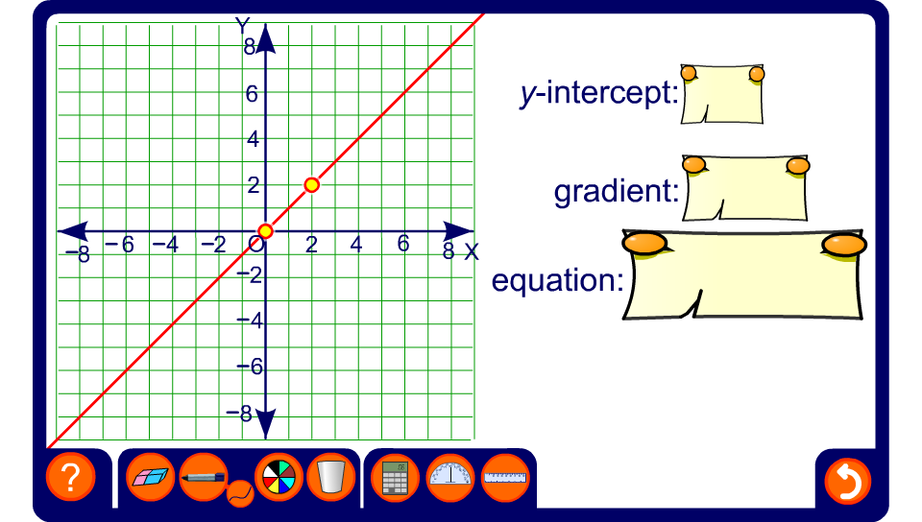


What is the equation of the line?

